Slide 1
BUSINESS ANALYTICS PROJECT-READY DATASET
NAME: OKPANKU IJEOMA
COURSE: BAN 6880
BUSINESS ANALYTICS CAPSTONE
MILESTONE 1 ASSIGNMENT
COURSE ID:158862

Slide 2
PROJECT OVERVIEW
Business Analytics project-ready dataset aims at collection and cleaning of dataset (with interest in its sources, methods and tools for collection & cleaning) ensuring that it is pre-processed and ready for use in the final business analytics project .
This project is key for business analytics knowing that analytics cannot be performed without collection of raw data which will further be cleaned making it useable, accurate, trustworthy as well as ensuring high quality and accurate modelling use.
The essence of this is aid the organisation to make better, faster and more efficient & informed decision(Team,2024)

Slide 3
DATA SOURCES
Dataset ( smart logistics dataset) was gotten from Kaggle (Kaggle,2024)
The Size: made up of 1000 rows and 16columns in its raw state before it was cleaned, after cleaning it remained at 1000 rows and 16 columns.
Data Types : made up of numeric (64floats and 64 integers), categorical (4 objects) with Timestamp inclusive.
This dataset was chosen, considering the business analytics problem it intends to analyse- Supply Chain Optimization which has a lot to do with; logistics (delay),inventory level, sales, date &time, traffic status, demand forecast, weather ,shipment, cost & more as contained in the dataset.

Slide 4
DATA COLLECTION PROCESS
Downloaded dataset from Kaggle in CSV format
Saved with the file name and content details put in a folder
Imported using pandas in Python
Dataset: Verified accessibility and Verified integrity

Slide 5
TOOLS AND METHODS FOR PROJECT ASSIGNMENT
TOOLS:
Visual Studio Code (VS Code) as IDE
Python 3.130 kernel for running the notebook
Pandas library (import pandas as pd) for data preparation
GitHub for storage.
METHOD:
Data Loading, Inspection and preparation using the Pandas method.

Slide 6
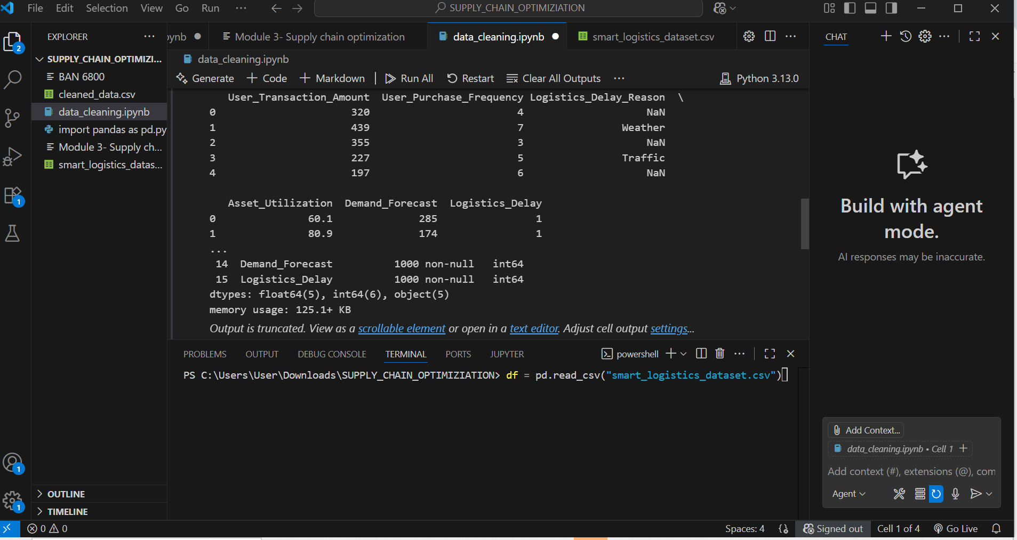
INITIAL DATSET INSPECTION
After loading the dataset , I carried out an initial dataset inspection & did a quick check:
Printed out a minimal nos of 5 rows out of the 1000rows
Defined and printed headers with print(df.head())
Carried out initial inspection of the dataset
Printed out info
Printed out the initial shape/nature of the dataset.: 1000rows x16 cols
• Info: df.info()
• Printed nos of floats and integers and objects.

Slide 7
DATA CLEANING STEPS
Checked for missing values before cleaning
Removed duplicates: The result showed that there were no duplicate
Handled missing values: dropped rows with missing values and it brought data to 737 rows while the columns remained the same.
I had the choice of replacing missing rows of numeric with median and categorical with mode which was the best option in order not to loose a lot of data, however considering that I had 737rows left after dropping which was still good enough, I chose to continue with the option of dropping data as I wanted to see the difference in my dataset after cleaning.

Slide 8
DATA CLEANING STEPS
However, after due consideration, rather than drop rows with missing values, I decided to impute numeric values with mean and median while categorical with mode (Geeks4Geeks,2024)
Handling of missing data was looked into in most columns such as the temperature, logistics delay, shipment and others.
This then brought my dataset back to 1000rows and 16 columns.
No data was lost eventually after handling missing values.

Slide 9
DATA CLEANING STEPS CONTINUATION
Standardized Timestamp: Pandas converted the Timestamp column toits internal standard(datetime64[ns] to conform with the ISO8601 format : YYYY-MM-DD-HH:MM:SS
This is said to be idea as it is efficient, avoids ambiguity, and year, month, weekday, hour etc can easily be extracted.

Slide 10
DATA TRANSFORMATION
Converted strings to datetime in the Timestamp column to adapt to the internal standard of pandas(dattime64[ns] being the method used.
Applying the mean and median to numeric columns
Applying the mode to Categorical (object) column.
A bit of modification emerged

Slide 11
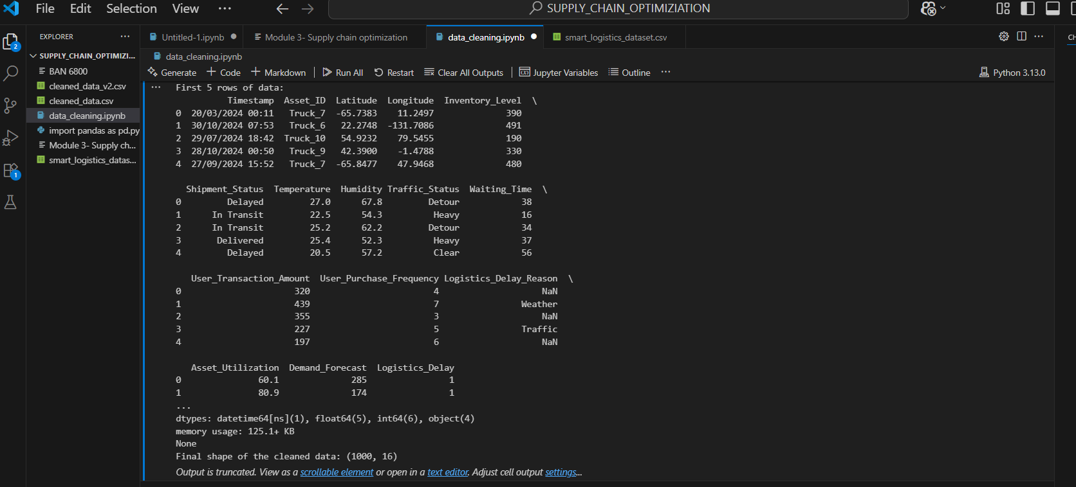
SNAPSHOT OF FINAL DATASET CAPTURE
The shape after cleaning remained at 1000 rows x16 columns
Saved as cleaned_data.csv in the SUPPLY_CHAIN_OPTIMIZATION FOLDER
Uploaded to GitHub repo

Slide 12
References
GeeksforGeeks. (2024, June 5). What is data cleaning? GeeksforGeeks. https://www.geeksforgeeks.org/data-analysis/what-is-data-cleaning/#1-handling-missing-data
Kaggle. (2024). Datasets | Kaggle. Kaggle.com. https://www.kaggle.com/datasets
Team, D. (2024, September 24). Benefits of Data Cleansing: Why It Matters for Your Business - DataBees. DataBees. https://getdatabees.com/benefits-of-data-cleansing

